Slide 1
Design and Analysis of Algorithm
Instructor: Muhammad Arif shah

Slide 2
Divide and Conquer Strategy
The Divide and Conquer is a strategy employed to solve a large number of computational problems
Divide: the problem into a small number of pieces
Conquer: solve each piece by applying divide and conquer to it recursively
Combine: the pieces together into a global solution

Slide 3
Merge Sort
Given an array A
Divide: split A down the middle into two subsequences, each of size roughly
Conquer: sort each subsequence by calling merge sort recursively on each
Combine: merge the two sorted subsequences into a single sorted list
The dividing process ends when we have split the subsequences down to a single item
A sequence of length one is trivially sorted
The key operation is the combining stage, which merges together the two sorted lists into a single sorted list

Slide 4
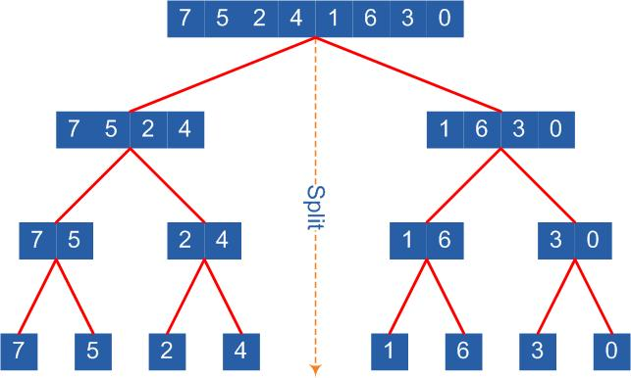
Merge Sort

Slide 5
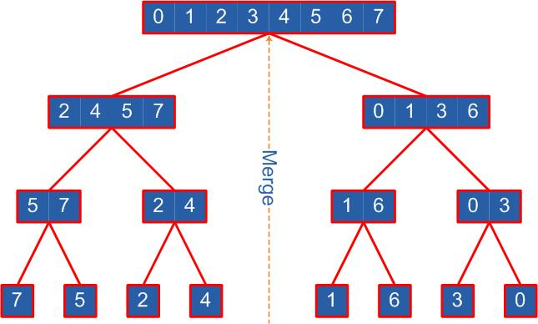
Merge Sort

Slide 6
Merge Sort Algorithm
MERGE-SORT(array A, int p, int r)
if (p<r)
then
q ← (p+r)/2
MERGE-SORT(A, p, q) //Sort A[p…q]
MERGE-SORT(A, q+1, r) //Sort A[q+1…r]
MERGE(A, p, q, r) //merge the two pieces

Slide 7
MERGE Algorithm
MERGE(array A, int p, int q, int r)
int B[p…r]; int i ← k ← p; int j ← q+1
while(i ≤ q) and (j ≤ r)
do if(A[i] ≤ A[j])
then B[k++] ← A[i++]
else B[k++] ← A[j++]
while(i ≤ q)
do B[k++] ← A[i++]
while (j ≤ r)
do B[k++] ← A[j++]
For i← p to r
do A[i] ← B[i]

Slide 8
Analysis of Merge Sort
First consider the procedure MERGE(A, p, q, r)
Let n = r-p+1 denote the total length of both left and right sub-arrays, i.e. sorted pieces
The MERGE procedure contains four loops, none nested in the other
Each loop can be executed at most n times
Thus running time of MERGE is Θ(n)

Slide 9
Analysis of Merge Sort
Let T(n) denotes the Worst-Case running time of MERGE-SORT on an array of length n
If we call MERGE-SORT with a array containing a single item (n=1) then the running time is constant
Means T(n) = 1
For n>1, MERGE-SORT splits into two halves, sorts the two and merges them together
The left half is of size and the right half is
How long does it take to sort elements in sub-array of size

Slide 10
Analysis of Merge Sort
We do not know this but because ˂ n for n ˃ 1, we can express this as T
Similarly, the time taken to sort right sub-array is expressed as T
In conclusion, we have

Slide 11
Solving the recurrence
This is called a recurrence relation i.e. a recursively defined function
Let’s expand the terms
Any pattern?

Slide 12
Solving the recurrence
Let’s consider the ratios for powers of 2
This suggests or
Which is

Slide 13
?

